Slide 1


Tokyo Airbnb – Technical Presentation
Date: October 3rd 2020
Presenter: Rick Takeuchi

Slide 2
Increasing overall revenue for Tokyo Airbnb by 40% requires either finding optimal neighborhoods for Airbnb bookings or discovering key variables that increase booking prices
!
Through the increased demand for Airbnb reservations, operational costs increased to host new listings. Too many listings in unideal areas will create potential deficits.
Problem 1:
Increased number of listings requires discovering ideal neighbourhoods for Airbnb development
!
People use Airbnb because of lower booking prices compared to hotels. Unfortunately, lower mean booking prices led to lower overall revenue. However, cost-effective listings can be used for budget travelers.
Problem 2:
Overly lower booking prices are detrimental to overall Airbnb regional revenues
!
Number of customers for Airbnb visits are highly impacted by previous customers’ reviews. If reviews are lower, smaller number of customers and potentially lower booking prices will make Airbnb unsuitable both in short and long term.
Problem 3
Lower review scores will lead to less customers and revenues in the future

Slide 3
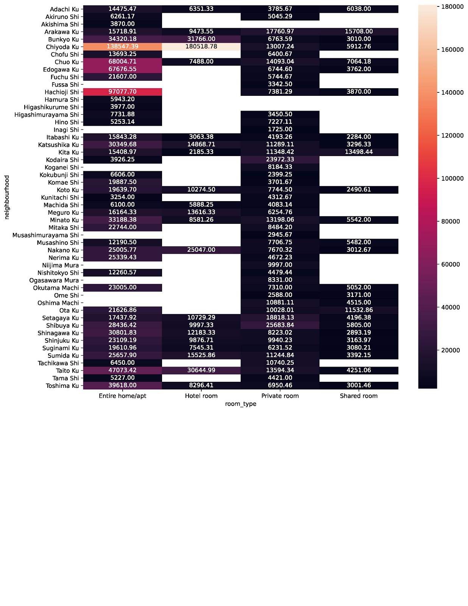
Neighborhood vs Property Type Shade Chart

Slide 4
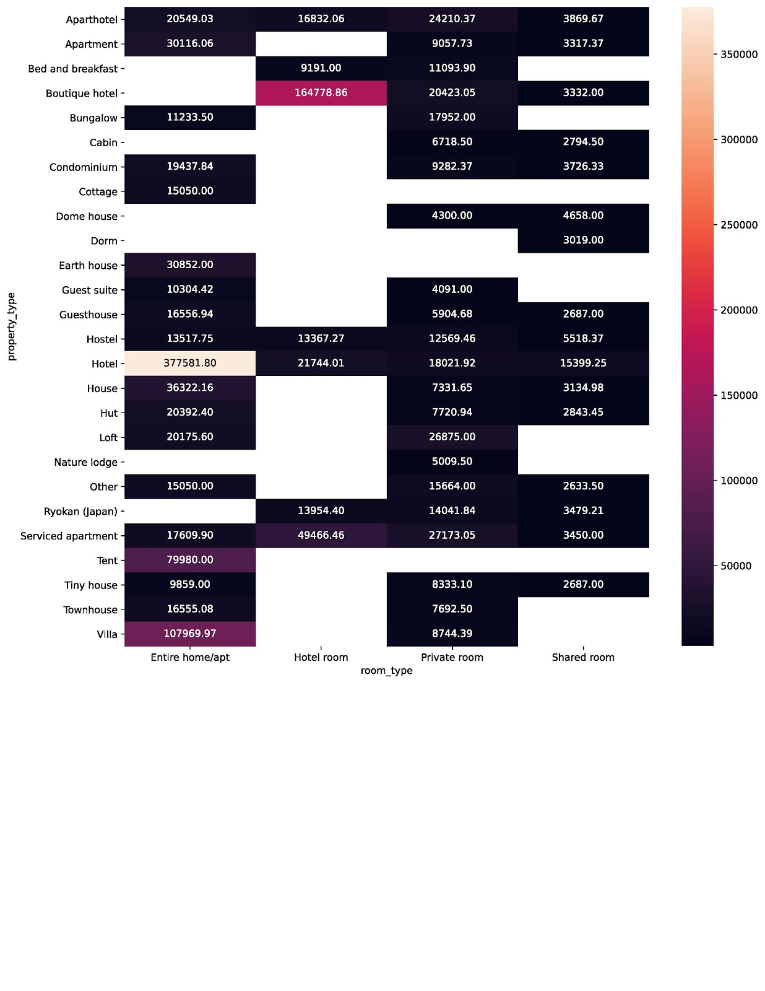
Through utilization of descriptive and inferential statistics, three (3) key variables that largely impact pricing of the property, enables two (2) heat maps capable of identifying ideal property types.
Key Insights
Heat Maps
Two Heat Maps are created based on the following: one with property type vs neighbourhood and one with room type vs property type. Python is used to group property type with either room type or neighbourhood to create heatmaps. The colour scale is based on mean price of each sub-category based from least to most expensive.
Further Insights
Although most cost effective or most expensive property type based on the three variables are found, it requires further analysis. If analysis isn’t performed, the engineers cannot dig deeper due to small amount of insights gathered in heat maps.
Source: Southern Water Corp Statistical Records

Slide 5
Correlations and combination of dot chart with bar graph were used through Python to provide insights on what impacts revenue of Tokyo Airbnb to increase by 40%.
What opportunities exist for Airbnb in Tokyo to increase overall regional revenue by 40%
through finding optimal neighborhoods for Airbnb bookings or finding key variables that
increases booking prices?
STATISTICAL APPROACH #1:
Dot Charts and Bar Graphs
STATISTICAL APPROACH #2:
Correlations & Correlation tables

Slide 6
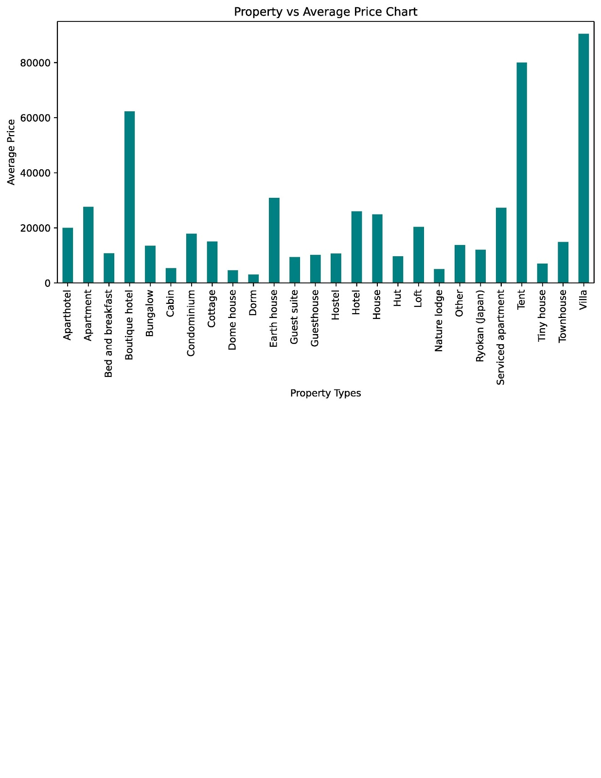
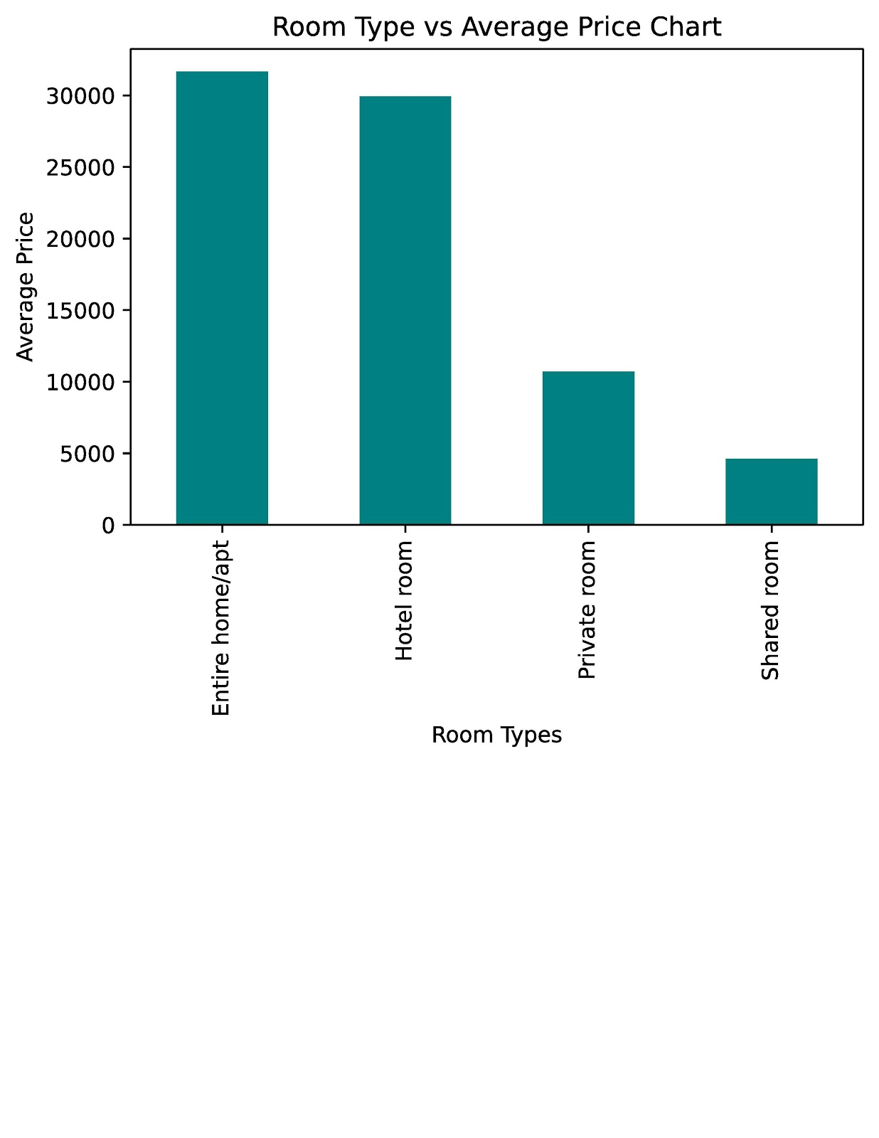
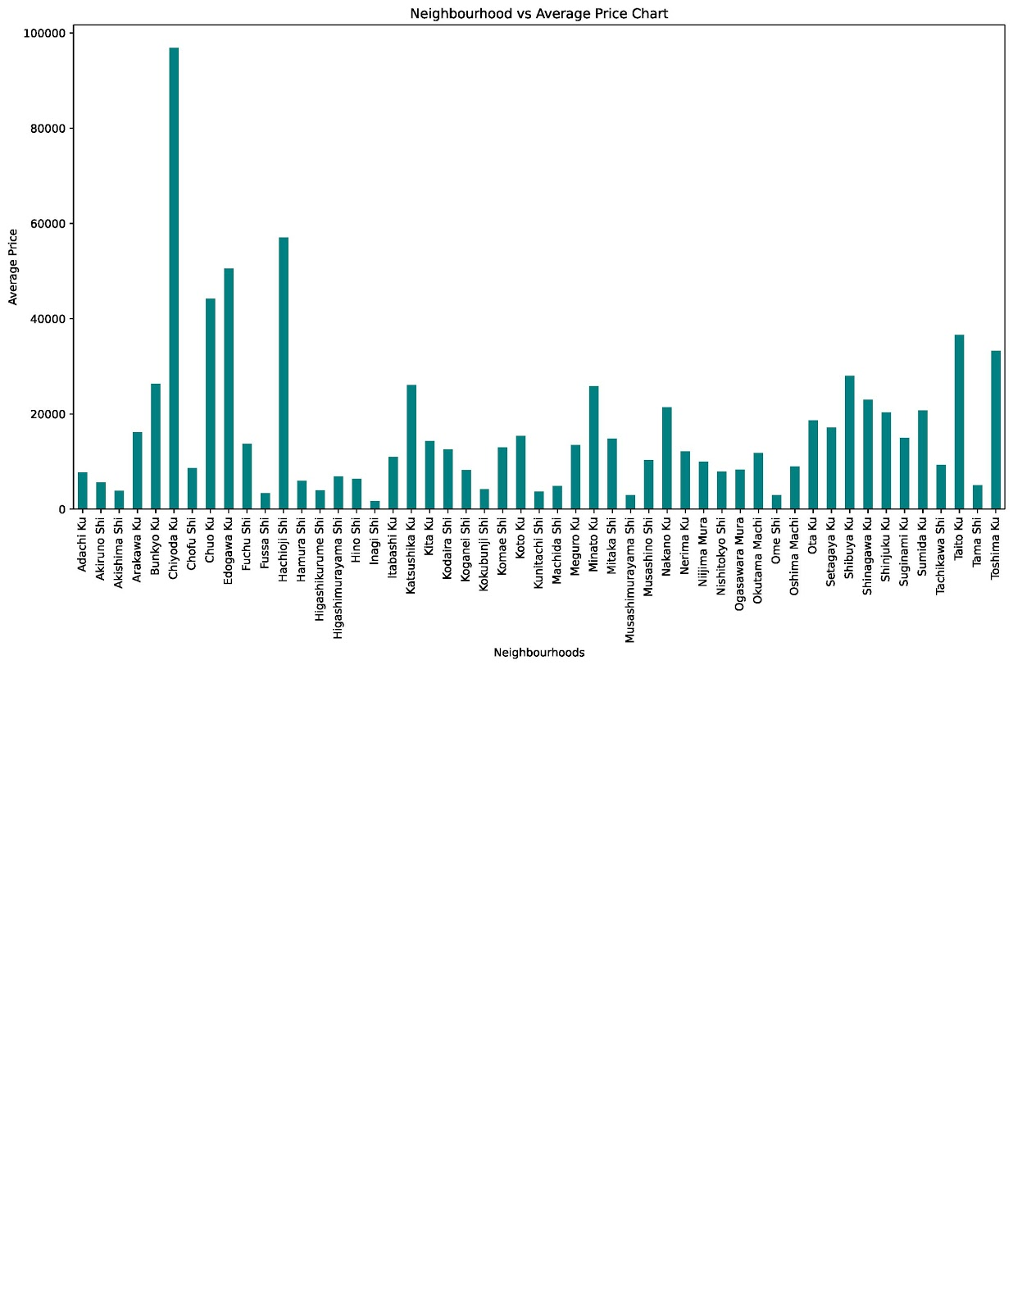
Applications of bar graphs through grouping property types or neighbourhoods by price in Python led to insights regarding ideal lodging for different types of travellers to provide more revenue
Key Insights
The average price of an entire home/apt is a lot higher than a private room and shared room. In order to generate more revenue, it will be wiser for Airbnb to list more entire homes and apartments due to larger portions of these types of listings and higher average price.
An entire home or apt in Chiyoda Ku can generate more hefty revenue than other neighborhood/room type combinations.
High occupancy rates in lowest price neighborhoods and/or property types can generate revenue if Airbnb caters these listings to low budget travelers and student travelers with minimal budget.
Most expensive property types can only generate large revenues if someone is interested in investing or renting these types of properties.
.

Slide 7
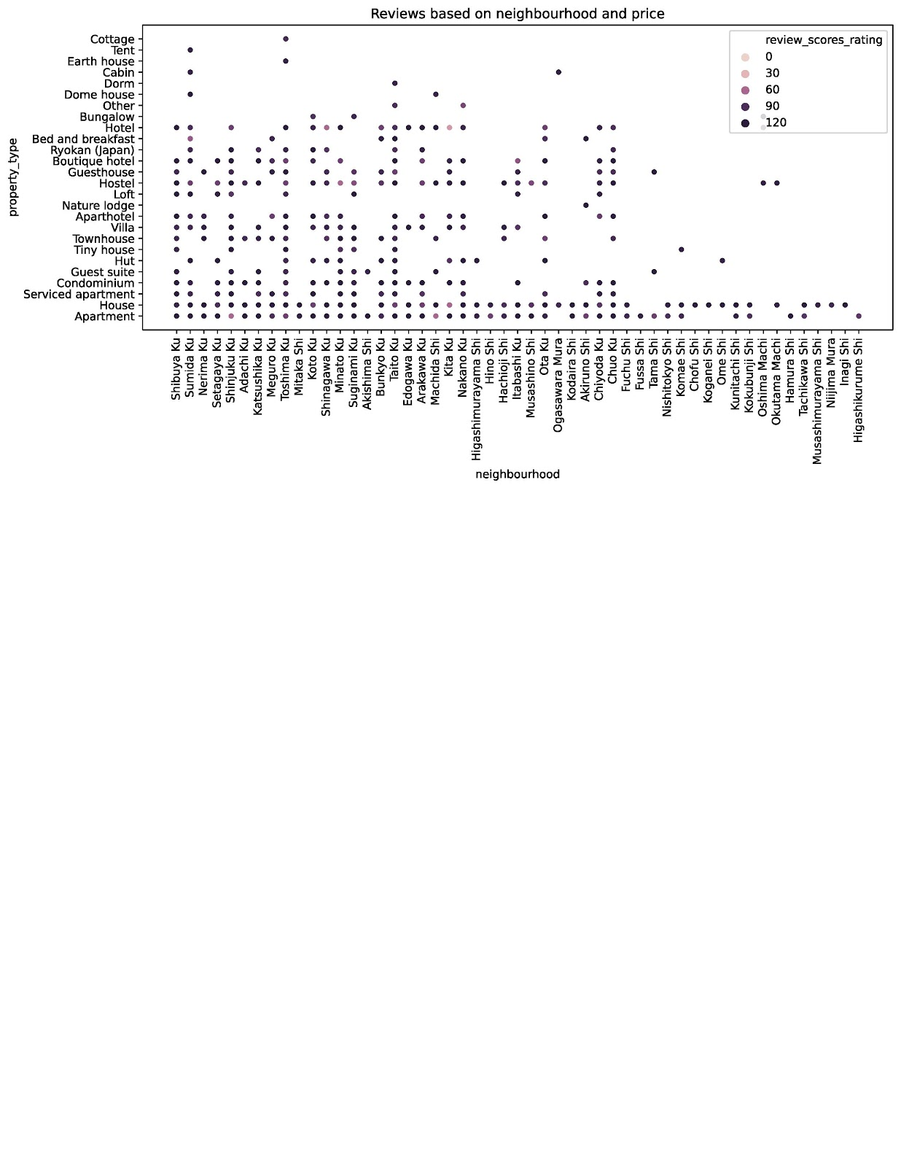
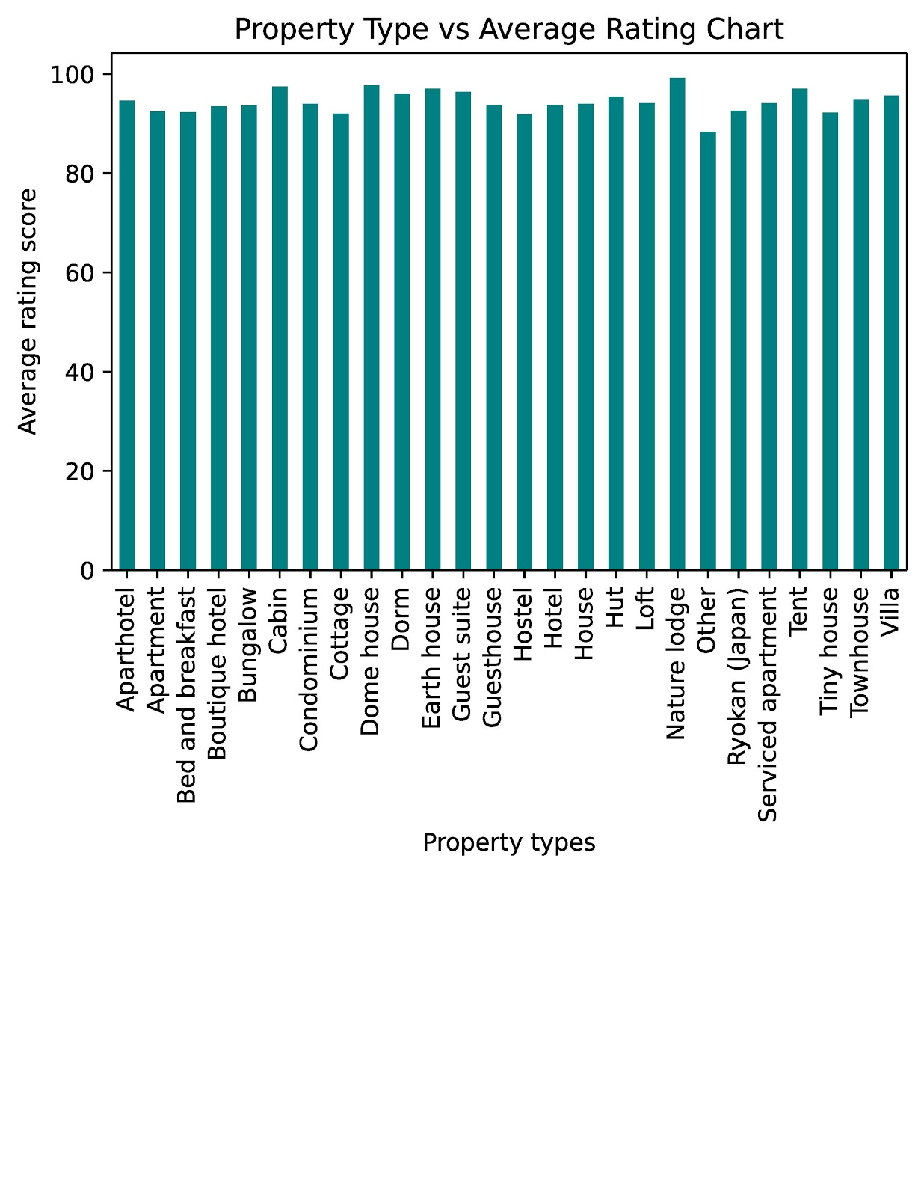
Application of dot chart and bar graph determines that Tokyo Airbnb properties have generally high reviews at over 80. However, insights are needed to determine which properties need special attention or not.
Key Insights
Nature lodges, Cabins, and Dome houses have high customer reviews and low average cost for these types of houses, which are essential for a solid potential based on return on investment.
The types of neighborhoods and properties that have poor average reviews and need more attention are:
Apartments in Shinjuku Ku
Apartments in Tama Shi
Houses and Hotels in Kita Ku
Hotels in Shinagawa Ku

Slide 8
Application of correlation matrix for property price with other variables yielded no variables that are strongly correlated with property price.
review_scores_value | -0.02
review_scores_communication | -0.01
review_scores_checkin | -0.01
review_scores_location | -0.01
review_scores_accuracy | -0.01
bathrooms | 0.00
review_scores_rating | 0.01
review_scores_cleanliness | 0.01
number_of_reviews | 0.02
beds | 0.05
bedrooms | 0.08
accommodates | 0.15
price_Yen | 1.00
Key Insights
Based on the correlation matrix, the results were inconclusive since price of the property cannot strongly correlate with key numerical variables.
Prices of the listing have little correlation with any other variables. The variables with highest correlations with listing prices are
Accommodates: 0.15
Bedrooms: 0.08
Beds: 0.05

Slide 9
Application of correlation matrix for overall reviews with other variables yielded three (3) key signals that strongly correlated with overall review ratings which boosted our confidence in the trend picked up in descriptive analysis
bathrooms | -0.02
price_Yen | 0.01
bedrooms | 0.04
beds | 0.06
accommodates | 0.07
number_of_reviews | 0.10
review_scores_location | 0.43
review_scores_checkin | 0.56
review_scores_communication | 0.58
review_scores_value | 0.69
review_scores_cleanliness | 0.71
review_scores_accuracy | 0.72
review_scores_rating | 1.00
Key Insights
Overall review ratings only have solid correlations with subcategories of review ratings. The subcategories are listed below as:
Accuracy: 0.72
Cleanliness: 0.71
Value: 0.69
Communication: 0.58
Check-in: 0.56
Location: 0.43
Based on the correlations above, accuracy of service, cleanliness, and value of the lodging are most valued by customers
The variable other than review subcategories that has the highest correlation with overall reviews is number of reviews at 0.10.

